Slide 1
Shell Bootcamp 2024 3 Reflections for Week 3
Jallipalli Lakshmi Susmitha Jayasri
Date : 13-Sep-2024

Slide 2

About Me
“I am not a person who just completes the task, I enjoy the process and grow through it”
Please share an image / visual that best represents you

Slide 3

My learnings from this week!

Slide 4
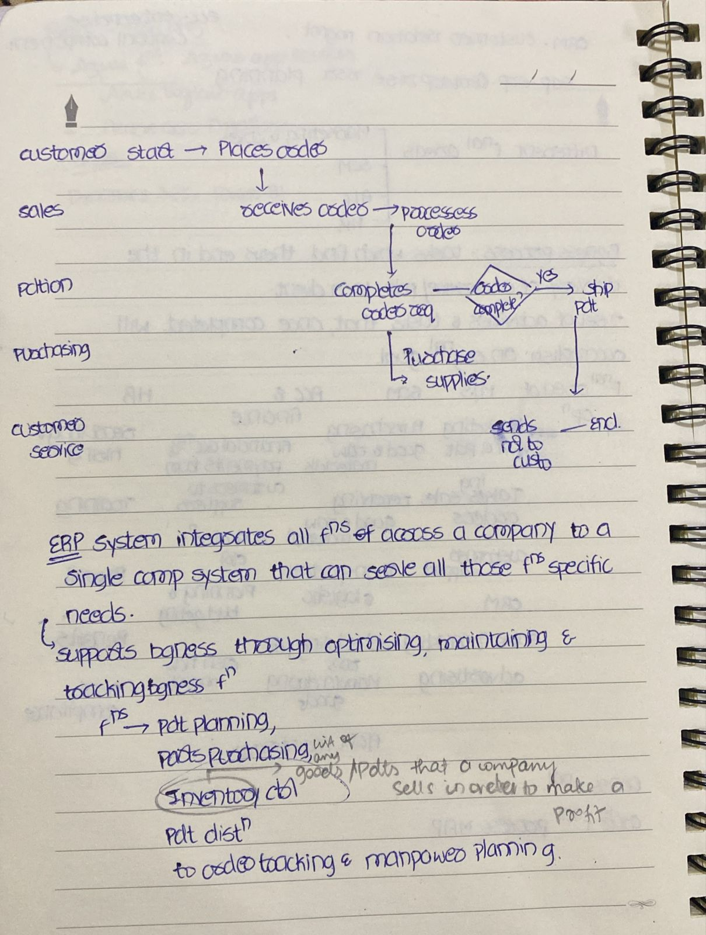
Learning 1 | My takeaways
Key Learnings: I have learned what exactly a business process and what are different functional areas of an organization and tasks involved in each functional area.
Key takeaways: To complete a task efficiently, all functional areas must collaborate, leveraging their unique expertise.
Just like in every other sector, cross functional collaboration ensures efficient resource management and adherence to safety and environmental regulation. Engineering, operations, and finance teams must align to optimize processes and reduce operational risks.
[Add a graphic that provides evidence of what you learned]

Slide 5
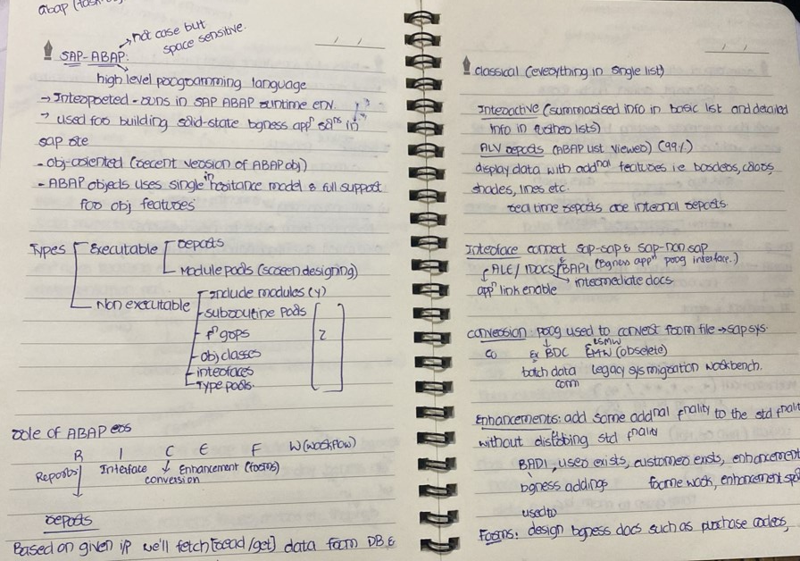
Learning 2 | My takeaways
Key learnings: I have learned how ABAP works and syntax of ABAP.
Key takeaways: ABAP is SAP’s language for developing applications, known for its integration with SAP HANA and emphasis on clean, maintainable code.
In Shell, ABAP is used to customize SAP ERP modules and manage large volumes of data efficiently, ensuring seamless integration and process automation within their IT landscape. Additionally, ABAP supports Shell’s digital transformation initiatives by enabling advanced analytics and real-time data processing.
[Add a graphic that provides evidence of what you learned]

Slide 6
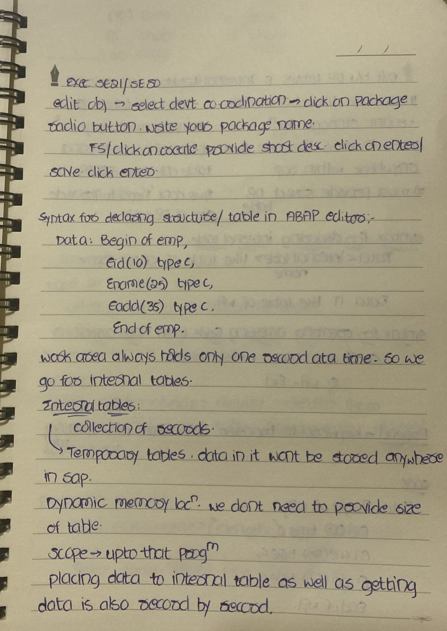
Learning 3 | My takeaways
Key learnings: I have learned how to write programs in ABAP and understood the syntax of it
Key Takeaways: I have learned syntax for data declaration, table declaration, different types of reports, queries for selecting and different t-codes for transactions and I have written many programs.
At Shell, ABAP would be used as front-end language for their ERP. It would be used to maintain and manipulate their data and create different reports and display data and implement selection screens
[Add a graphic that provides evidence of what you learned]

Slide 7

Relevance of learnings for my organization

Slide 8
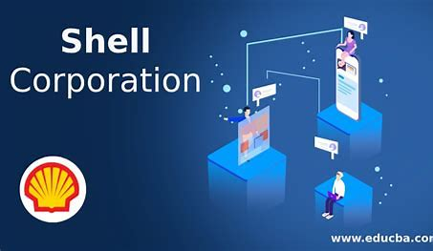
Learning 1 | Relevance for Shell
Shell implements its business processes through integrated business areas like Integrated Gas, Upstream, and Downstream, supported by strategic planning and advanced supply chain management systems.
Cross-functional teams at Shell consist of diverse members from various departments, working together with clear goals and effective communication. This collaboration drives innovation, efficiency, and continuous improvement, ensuring that Shell meets its objectives and adapts to changing market demands.
[Add a graphic that provides view of how Shell implements this learning]

Slide 9
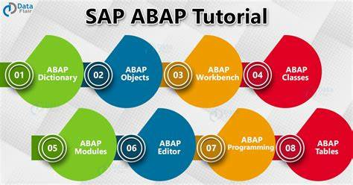
Learning 2 | Relevance for Shell
ABAP (Advanced Business Application Programming) remains highly relevant, especially within the SAP ecosystem. It is essential for customizing and enhancing SAP applications, enabling real-time data processing, and integrating advanced analytics and machine learning.
Shell, a global energy company, leverages ABAP to drive digital transformation and sustainability initiatives, customizing SAP applications to meet specific business needs like carbon accounting and supply chain management.
[Add a graphic that provides view of how Shell implements this learning]

Slide 10
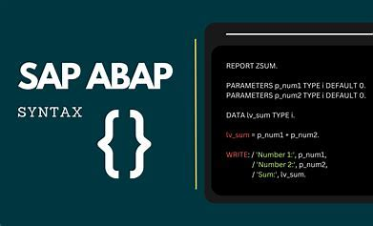
Learning 3 | Relevance for Shell
The SELECT query in ABAP is fundamental for retrieving data from database tables, which is crucial for Shell’s operations. It allows for efficient data extraction, enabling real-time analytics and decision-making. For instance, Shell can use SELECT queries to track supply chain activities and manage financial transactions.
Shell can define custom tables to store specific business data, such as environmental metrics or project management details. This customization helps in aligning SAP applications with Shell’s unique business processes. For example, Shell might create tables to track carbon emissions data, which can then be queried and analyzed to support sustainability initiatives
[Add a graphic that provides view of how Shell implements this learning]

Slide 11

Challenges in implementing learning

Slide 12

Challenge faced while implementing Learning 1
Challenge: Understanding business process and how it works has been difficult for me
Plan: I have understood by studying various case studies that helps me understand that.

Slide 13
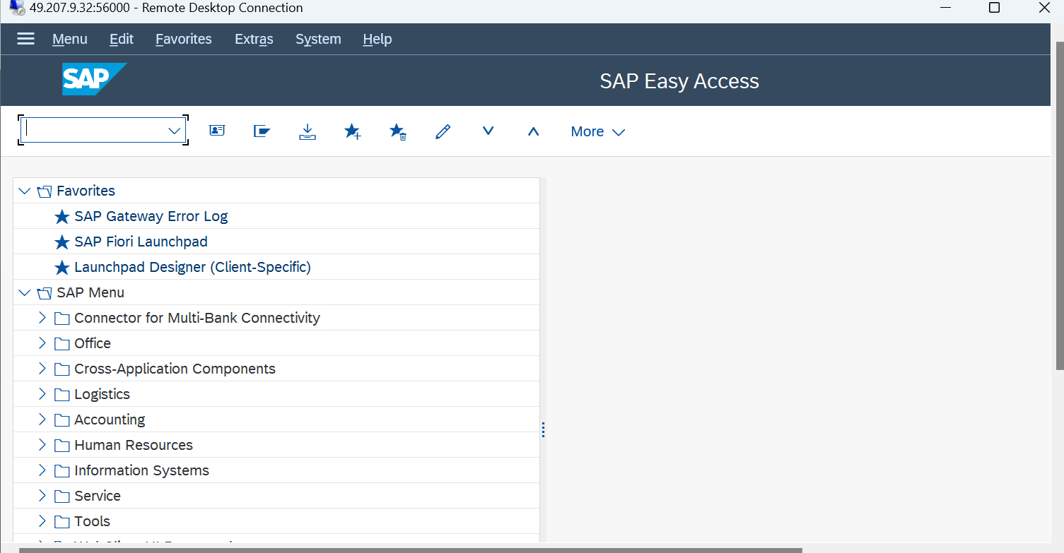
Challenge faced while implementing Learning 2
Challenge: I am not familiar with SAP GUI and its usage.
Plan: I started using website more to get more familiarized with it
[Add a graphic that provides evidence of what you did to overcome this challenge]

Slide 14
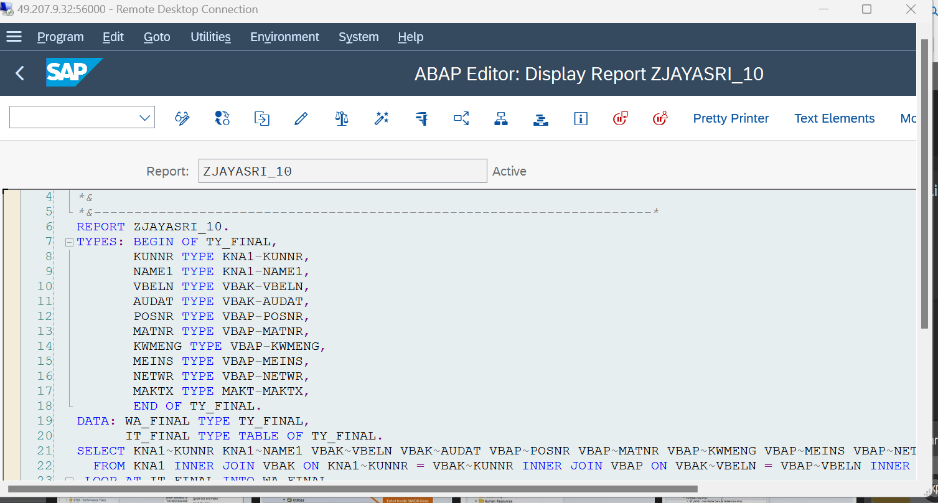
Challenge faced while implementing Learning 3
Challenge: I have difficulty in understanding the syntax of ABAP.
Plan: I kept practicing codes and tried to improve knowledge on it.
[Add a graphic that provides evidence of what you did to overcome this challenge]

Slide 15

Action Plan

Slide 16
My Action Plan for this Week
Actions
Timeline
Status
Understand and more familiarized with ABAP language
Practice ABAP and write more code
Completed

Slide 17

Learning is also Fun!

Slide 18

Learning is also Fun!
My facilitator for custom ERP training Mr. Mir Moheeb Ali has been very patient and made sessions very interactive and fun. We had hands on training on SAP.
He made sessions very interactive and explained all the concepts very nicely. He made sessions quite informative and interactive.
[Add a graphic or a picture of how you/your team enjoyed the new learning]

Slide 19

Summary
Quick Summary:
ABAP is object oriented programming language that helps us in implementing modules in SAP-ERP.
RICEFW are the main concepts in ERP which are Reports, Interfaces, Conversions, Enhancements, Forms, Workflow
Importance of topics in upcoming week:
BTP and S4 HANA and functional part of SAP are the topics for next week.
Since Shell implements ERP, BTP can be used as a front-end language and HANA is the database with high analytical capabilities.
Connectivity of topics from current week:
BTP is front-end language whereas ABAP is back-end language.

Slide 20
Thank You

